Slide 1

Basic Details of the Team and Problem Statement
Ministry/Organization Name/Student Innovation: Ministry of Law and Justice
PS Code: 1286
Problem Statement Title: Incentives based Design for onboarding Legal Service Providers such as Advocates, Arbitrators, Mediators, Notaries, Document Writers, etc on eMarket Place for extending Legal Services to Citizens in India
Team Name: The Justice League
Team Leader Name: Sasha Vinod
Institute Code (AISHE): U-1153
Institute Name: Shiv Nadar University Chennai
Theme Name: Software

Slide 2
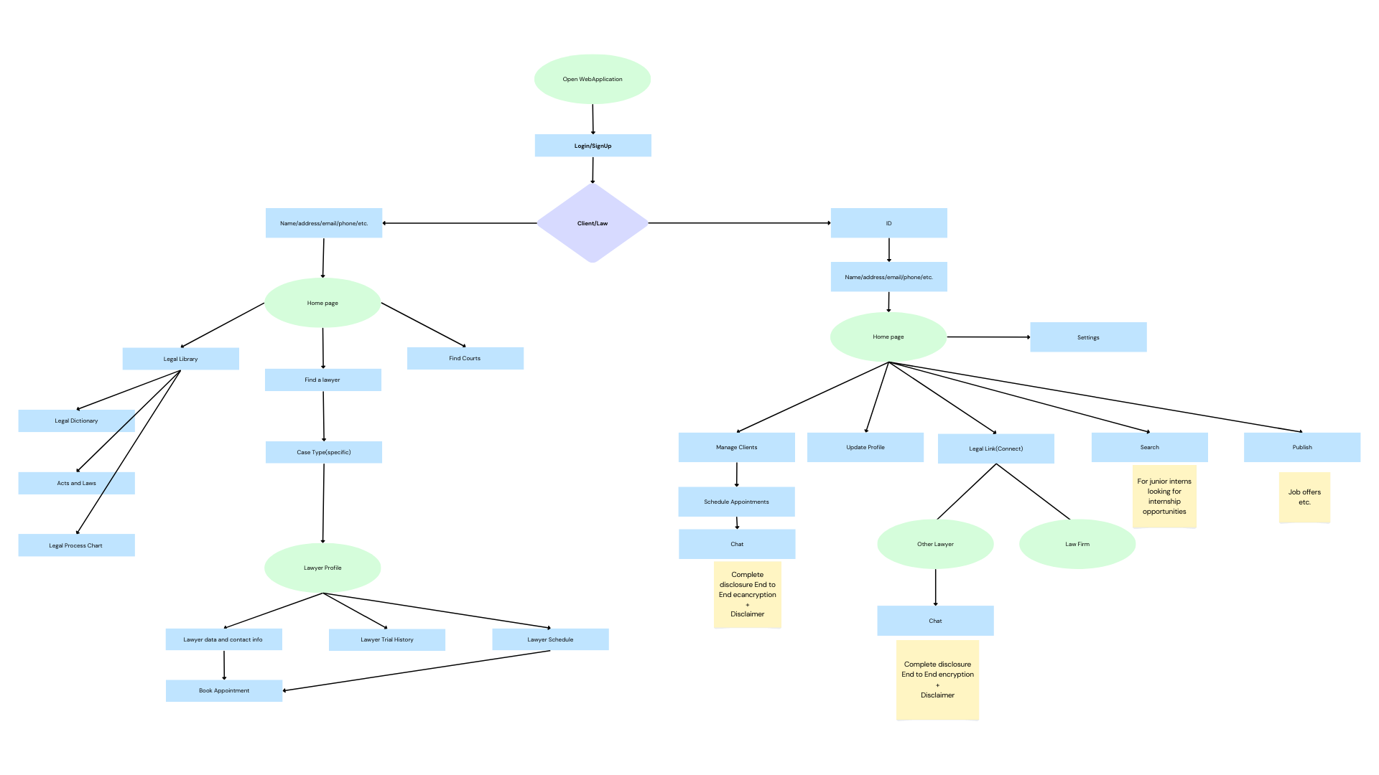
Idea/Approach Details
Describe your idea/Solution/Prototype here:
We propose a web based solution, which connects the people to the legal system and strengthens the connections within the legal system by implementing the following features:
People can search for lawyers and find the best match for their unique problem, budget, location, etc.
People can also familiarise themselves with various legal processes and look up various jargons and acts commonly used in the legal literature.
Lawyers have a profile which shows their area of expertise, recent court proceeding records(the one’s allowed for public access by the (supreme)court), this profile system makes it easier for clients to identify their preferred lawyer and at the same time help the lawyer create a reputation and connections(Legal Link).
Junior lawyers can find internships from solo lawyers or legal firms, and lawyers or firms can easily find talented interns
Describe your Technology stack here:
Front End: HTML/CSS/JavaScript
Frameworks used(Front End): Petite Vue, Bootstrap
Back End: Firebase
Frameworks used(Back End): Firebase Cloud functions

Slide 3
Idea/Approach Details
Describe your Use Cases here
Describe your Dependencies / Show stopper here
Our web application connects the common man to the people of law, and provides legal assistance through various mediums like a legal dictionary.
It saves valuable time as it digitises the process of selecting a legal professional.
It enables the client to search for legal professionals based on their legal issue, budget and location.
It familiarises the common man with the various legal processes and jargons involved through engaging methods like “loading screen pop-ups”.
It establishes communication amongst legal professionals.
Using LegalLink lawyers can easily link with other legal professionals and firms for various purposes ranging from application to recruitment.
Allows legal professionals to recommend other legal professionals. This enables legal professionals to refer a client to a colleague for various reasons like scheduling conflicts.
Our web application is based on immense databases collected from various different courts of different region and level
The legal system has the say in what record goes public hence our database cannot be complete
Communications between Legal professional and client may lead to leak of sensitive data(Site doesn’t recommend talking about the case under chat)
Requires internet to access

Slide 4
Team Member Details
Team Leader Name: Sasha Vinod
Btech CSE II
Team Member 1 Name: Swaathi S
Btech CSE II
Team Member 2 Name: Deepika P
Btech CSE II
Team Member 3 Name: Saeshwaran A
Btech CSE II
Team Member 4 Name: Kruthika Eleswarapu
Btech CSE II
Team Member 5 Name: V Susena
Btech CSE II
Team Mentor 1 Name: Type Your Name Here
Category (Academic/Industry): Expertise (AI/ML/Blockchain etc): Domain Experience (in years):
Team Mentor 2 Name: Type Your Name Here
Category (Academic/Industry): Expertise (AI/ML/Blockchain etc): Domain Experience (in years):

